Slide 1

Problem Solving In Computing
Notes:
Welcome to Programming I Lecture 1 on Problem Solving in Computing
There is only one audio file in week 1. Please listen to it. Thanks.

Slide 2
Objectives
At the end of this lecture, you will be able to
apply steps to solve problems in computing
Notes:
Problem Solving In Computing
This lecture will introduce you to the basic goal of the module – understanding problems and solving them using computers.

Slide 3

What Is Problem Solving?
People make decisions everyday to solve problems that affect their lives
Which polytechnic to go?
Which course to take?
Where to go for lunch after class?
whatisengineering.com
Notes:
People make decisions everyday to solve problems that affect their lives.
In order to solve a problem, we must first understand the problem. We may need to read the problem statement a number of times to ensure that we understand what is asked before attempting to solve it.
The following steps need to be done:
read the problem statement carefully
understand what the problem entails
write down the steps to solve the problem

Slide 4
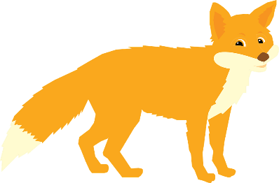
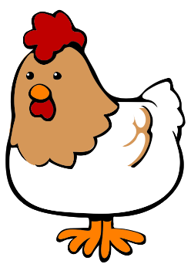
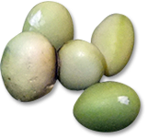
Problem Scenario
Farmer Joe bought a fox, a chicken and a bag of beans. He hires a boat for $20 to cross a river that is 50m wide, but can carry only one item at a time.
He needs to bring the purchases across the river to get home.
If left unguarded, the fox would eat the chicken, and the chicken would eat the beans.
How can you solve the problem that Farmer Joe faced – to get his purchases across the river?
Notes:
Spend some time to read through this Problem Scenario.
Question - How can you solve the problem that Farmer Joe faced, which is, to get his purchases across the river?

Slide 5
Problem Solving Process
5-step problem solving process that involves brainstorming, analyzing and testing until the optimal solution is reached
It is important that all steps be done in order
Identify and Define
the problem
Analyze
the problem
Identify
possible solutions
Select and Plan
the solution
Implement & Evaluate
the solution
Notes:
Problem solving consists of using generic or ad hoc methods, in an orderly manner, for finding solutions to problems.
There are 5 steps in the problem solving process that involves brainstorming, analyzing and testing until the optimal solution is reached.
It is important that all steps be done in order.

Slide 6

What Is A Problem?
Setting out to achieve some objective or desired state of affairs and can include avoiding a situation or event
All problems have two features in common:
Goals
Barriers
advanced-pcs.com
Notes:
Problems involve setting out to achieve some objective or desired state of affairs and can include avoiding a situation or event.
All problems have two features in common:
Goals
Barriers

Slide 7

Setting Goals
Goals are:
anything that you wish to achieve
where you want to be
social.quintloyalty.com
Notes:
Setting Goals
Goals can be anything that you wish to achieve, where you want to be.
If you are hungry then your goal is probably to eat something.
If you are a head of an organization (CEO) then your main goal may be to maximize profits. The main goal may need to be split into numerous sub-goals in order to fulfil the ultimate goal of increasing profits.

Slide 8
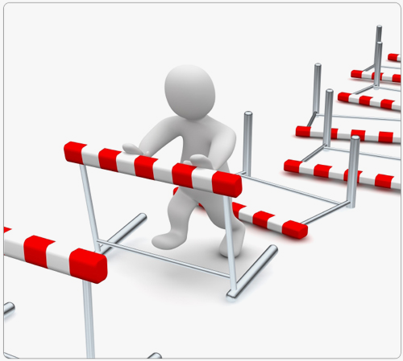
Know Your Barriers
Barriers
Problem solving involves overcoming the barriers or obstacles that prevent the immediate achievement of goals
blog.pistolstar.us
Notes:
Know Your Barriers
If there were no barriers in the way of achieving a goal, then there would be no problem.
Problem solving involves overcoming the barriers or obstacles that prevent the immediate achievement of goals.
If you feel hungry then your goal is to eat. A barrier to this may be that you have no food available. You take a trip to the supermarket and buy some food, removing the barrier and thus solving the problem.
If the CEO wants to maximize profits, he needs to attempt to recognize these barriers and remove them.

Slide 9
Step 1. Identify And Define Problem
Recognize the existence of a problem
Separate out the irrelevant and focus on the relevant issues that can solve the problem
Identify and name the problem
Write down the problem in a clear and concise statement
Problem
Farmer Joe needs to cross the river so as to bring a fox, a chicken, and a bag of beans home but he can only bring one item at a time when crossing. If left unguarded, the fox would eat the chicken, and the chicken would eat the beans.
Notes:
Step 1. Identify And Define Problem
When we are given a problem to solve, we have to read the problem carefully.
We may have to read the problem statement a number of times to be very sure that we understand and recognize the existence of the problem.
Identify and name the problem is to write down the problem in a clear and concise statement.
Read the problem defined for the Problem Scenario in Slide 4:
Farmer Joe needs to cross the river so as to bring a fox, a chicken, and a bag of beans home but he can only bring one item at a time when crossing. If left unguarded, the fox would eat the chicken, and the chicken would eat the beans.

Slide 10
Step 1. Identify And Define Problem
Set a goal
Focus on what is the successful end of the process
Making a goal statement also helps to see the gap between the problem and the goal
Goal
To help Farmer Joe get home with all his purchases
Notes:
To set a goal, we need to focus on what is the successful end of the process.
Questions asked may include:
What is it that you want to achieve?
What would it be like without the problem?
Making a goal statement also helps to see the gap between the problem and the goal.
For the Farmer's Problem, the goal set would be:
To help Farmer Joe get home with all his purchases

Slide 11
Step 2. Analyze The Problem
Analyze it to see what is involved in the problem
Gather information
If there is not enough information, figure out how to research and collect it
Barriers
Farmer Joe can carry only one item at a time
If left unguarded, the fox would eat the chicken, and the chicken would eat the beans.
Notes:
Step 2. Analyze The Problem
Analyze the problem to see what is involved. Some problem statements may contain unnecessary or irrelevant information which may be deleted to make the problem easier to read and understand.
On the other hand, some problem statements may have some missing data or information which requires the solver to supply.
The barriers or constraints for the Farmer's problem are as follows:
Farmer Joe can carry only one item at a time
If left unguarded, the fox would eat the chicken, and the chicken would eat the beans.

Slide 12
Step 3. Identify Possible Solutions
Develop possible solutions
Brainstorm to identify all possible solutions or variations
Allow time for clarifications or suggestions
Achieve common understanding
Notes:
Step 3. Identify Possible Solutions
To develop possible solutions
Brainstorm to identify every possible solution or variation.
There are no wrong answers here, and judgments should not be passed on another person’s suggestions.
Allow time for each person to clarify his or her suggestion so there is a common understanding for a later selection.

Slide 13
Step 4. Select And Plan The Solution
Select the best solution to fix the problem given the circumstances, resources, and other considerations
Things that can effect a solution: money, time, people, procedures, policies, rules, and so on
Prioritize the solutions into what would work best
This is a slow process of elimination
Discuss those solutions and come to consensus on the best solution
Notes:
Step 4. Select And Plan The Solution
Select the best solution to fix the problem given the circumstances, resources, and other considerations that will effect the solution.
Things that can effect a solution may include money, time, people, procedures, policies, rules, and so on.
Prioritize the solutions into what would work best
This is a slow process of elimination. Eventually, this could be reduce to one or two best solutions.
Discuss those solutions and come to consensus on the best solution.
Now that the solution is selected, plan for:
what needs to be done?
how is it to be done?
who should do it?
when should it be started?
when should it be completed?
what other resources are needed to do it?

Slide 14
Step 5. Implement & Evaluate The Solution
Create an action list
What needs to be done and by whom?
Step-by-step instructions that can be understood and executed
Evaluate the results to determine if it is the best possible solution to the problem
Notes:
Step 5. Implement & Evaluate The Solution
Create an action list to include the following:
What needs to be done and by whom?
Step-by-step instructions that can be understood and executed.
Evaluate the results to determine if it is the best possible solution to the problem.
Questions to consider could be:
How effective was that solution?
Did I achieve what I wanted?
What went right, and what went wrong?
What adjustments to make the solution work better?

Slide 15
Problem Solving
in
Computing

Slide 16
Problem Solving in Computing
Generic Computing
Identify and Define
the problem
Understand the Problem
Analyze
the problem
Identify
possible solutions
Formulate a Model
Select and Plan
the solution
Develop an Algorithm
Implement & Evaluate
the solution
Write the Program
Test & Evaluate the Program
Notes:
Problem Solving in Computing
Solving problems is the core of computing. Programmers must first understand how a human solves a problem, then understand how to translate this step-by-step instructions "algorithm" into something a computer can do, and finally how to implement or "write" the specific syntax (required by a computer) to get the job done.
Compare the steps taken for a generic 5-step problem-solving process versus the 5 steps that you should follow in order to solve a computing problem:
Understand the Problem
Formulate a Model
Develop an Algorithm
Write the Program
Test and Evaluate the Program

Slide 17

STEP 1: Understand The Problem
You need to know:
What input data/information is available?
Do I have everything that I need?
What format is it in?
What output information am I trying to produce?
What do I want the result to look like … text, a picture, a graph …?
What am I going to have to compute?
vhl.org
Notes:
STEP 1: Understand The Problem
To understand a computing problem, you need to know:
What input data or information is available?
Do I have everything that I need?
What format is it in?
What output information am I trying to produce?
What do I want the result to look like …example a text or a picture or a graph …?
What am I going to have to compute?

Slide 18

STEP 1 - Example
Calculate the body mass index (bmi) of John and display the result on the screen.
Input:
Not available in the problem statement.
User need to input the height (in m) and weight (in kg)
Process:
Formula for bmi is
Calculate the bmi based on input
Output:
Bmi result is displayed on the screen
Notes:
Consider this problem : To calculate the body mass index (bmi) of John and display the result on the screen.
To understand the problem, we need to know the following:
What input data/information is available ? What does it represent ? What format is it in ?
In this case, input data is not available in the problem statement.
User will need to input the height (in metre) and weight (in kilogram)
What output information am I trying to produce ?
The bmi result of John is to be displayed on the screen
What am I going to have to compute ?
The bmi needs to be calculated based on the input height (in metre) and weight (in kilogram).
Formula for BMI is given so the input height and weight can be applied to the formula.

Slide 19
STEP 2: Formulate A Model
It is all about figuring out how to make use of the available data to compute an answer
E.g., to compute the bmi of John based on input (height & weight)
Need to know the model (or formula) for computing bmi
If there is no such "formula", we need to develop one
Notes:
STEP 2: Formulate A Model
This step is all about figuring out how to make use of the available data to compute an answer.
E.g., To compute the bmi of John based on input (height and weight)
We need to know the model (or formula) for computing bmi, which in this case, is given or made available.
If there is no such "formula" available, we will need to figure out how to make use of the available data to develop one.

Slide 20

STEP 3: Develop An Algorithm
Have a precise plan of what we want the computer to do using an algorithm
Informally, an algorithm is like a recipe
A set of steps that must be written in an unambiguous and precise manner
An algorithm to solve a computer-based problem consists of 3 phases:
Input: what is available for the algorithm to solve
Process: how to solve the problem
Output: what is the required result
123rf.com
Notes:
STEP 3: Develop An Algorithm
There is a need to present the instructions in a precise way that is understandable to a person who is trying to figure out the steps involved by using an algorithm.
An algorithm is a set of steps or instructions that must be written in an unambiguous and precise manner
An algorithm to solve a computer-based problem consists of 3 phases:
Input: what is available for the algorithm to solve
Process: how to solve the problem
Output: what is the required result

Slide 21
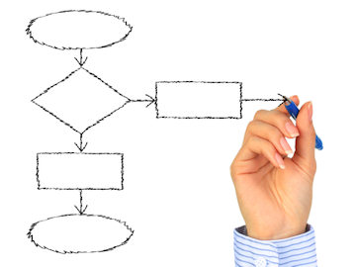
STEP 3: Develop An Algorithm
2 commonly used representations for an algorithm
Pseudocode
A simple and concise sequence of English-like instructions to solve a problem
Important to write pseudocode to help to clearly understand the problem to be solved
Flowcharts
A diagrammatic representation of an algorithm
Notes:
There are 2 commonly used representations for an algorithm:
Pseudocode
Pseudocode is a simple and concise sequence of English-like instructions to solve a problem.
It is often used as a way of describing a computer program to someone who does not understand how to program.
It is important to write pseudocode as it helps to clearly understand the problem to be solved
Flowcharts
A flowchart is a type of diagram that represents a workflow or process.
A flowchart can also be defined as a diagrammatic representation of an algorithm, a step-by-step approach to solving a task.

Slide 22
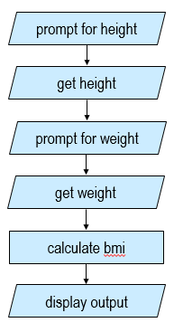
STEP 3 - Example
Calculate the body mass index of John and display the result on the screen.
Flowchart
Pseudocode
Prompt user for the height in m
Get height
Prompt user for the weight in kg
Get weight
Calculate bmi = weight / (height * height)
6. Display weight, height & bmi
Notes:
This illustrates how the algorithm on bmi calculation can be represented in English-like instructions using pseudocode or diagrammatically in a flowchart.

Slide 23

STEP 4: Write The Program
Transform the algorithm from Step 3 into a set of instructions that can be understood by the computer
Writing a program is often called "writing code" or “implementing an algorithm”
The code (source code) is actually the program itself
fotosearch.com
Notes:
STEP 4: Write The Program
This step involves transforming the algorithm from Step 3 into a set of instructions that can be understood by the computer, i.e., writing a program.
Writing a program is often called "writing computer code" or “implementing an algorithm”. The computer code is actually the program (which is also commonly called the source code). Source code would vary depending on programming language used.

Slide 24
STEP 4 - Example
Pseudocode
Prompt user for the height in m
Get height
Prompt user for the weight in kg
Get weight
Calculate bmi = weight / (height * height)
6. Display weight, height & bmi
# This program calculates the body mass index of a person
height = float(input('Enter your height in m: '))
weight = float(input('Enter your weight in kg: '))
bmi = weight / (height * height)
print('Your height is ' + str(height) + 'm')
print('Your weight is ' + str(weight) + 'kg')
print('Your bmi is ' + str(bmi))
Notes:
The left box refers to the pseudocode written to calculate the body mass index of a person.
Step 1 to 4 refers to the INPUT needed for the algorithm to solve
Step 5 refers to the PROCESS on how to solve the problem
Step 6 refers to the OUTPUT which is the required result
The right box refers to the program written in Python language to solve the problem based on the pseudocode.
Not to worry if you do not quite understand the statements. We will be going more into details on the syntax of the statements in the later lectures.

Slide 25
STEP 5: Test & Evaluate The Program
Ensure that program solves the problem that it was intended to solve and that the solutions are correct
When you run (execute) your program, you should see the correct output
Notes:
Step 5: Test & Evaluate The Program
This step ensures that the solution, in the form of a computer program, solves the problem that it was intended to solve and produces the expected result or outcome.
When you run (or execute) your program, you should see the intended output.

Slide 26
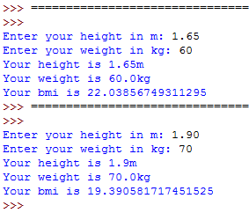
STEP 5: Example
Output
# This program calculates the body mass index of a person
height = float(input('Enter your height in m: '))
weight = float(input('Enter your weight in kg: '))
bmi = weight / (height * height)
print('Your height is ' + str(height) + 'm')
print('Your weight is ' + str(weight) + 'kg')
print('Your bmi is ' + str(bmi))
Notes:
The left box refers to the program written in Python language to calculate the body mass index of a person.
The right box refers to the expected output when the program is executed or run.
If you have installed Python, you can try creating a new file called CalBMI.py, key in the Python codes and try running the program. As mentioned, we will be going more into details on the syntax of the statements in the later lectures.

Slide 27
STEP 5: Test & Evaluate The Program
It is possible that your program works correctly for some set of data input but not for all
If the output of your program is incorrect:
It is possible that algorithm was not converted properly into a proper program
It is also possible that a proper algorithm was not done e.g. Some instructions may be out of sequence
Notes:
It is possible that your program works correctly for some set of data input but not for all.
If the output of your program is incorrect:
It could be possible that the algorithm was not converted correctly into a proper program, or
It could be possible that a proper algorithm in step 3 was not done to handle various possible situations.
Such problems with your program are known as logic errors.
The process of finding and fixing errors in your code is called debugging. This is a very time-consuming “chore”. If you take your time to carefully follow the problem solving steps 1 through 3, this should greatly reduce the amount of errors in your programs and it should make debugging much easier.

Slide 28

STEP 5: Test & Evaluate The Solution
Once your program produces a result that seems correct, you need to re-consider the original problem and make sure that the answer is formatted into a proper solution to the problem
Program solution may not solve the problem the way that you wanted it to
More steps may be involved
dreamstime.com
Notes:
Once your program produces a result that seems correct, you need to evaluate or re-consider the original problem and make sure that the answer is formatted into a proper solution to the problem.
The program solution may not solve the problem the way that you wanted it to and if so, more steps may need to be involved.

Slide 29
Activities
Practical activities are in a separate file (Word document)
You are required to submit your solutions for the activities in POLITEMall when you have completed all of them
Notes:
Do try out the activities in the word document found in POLITEMall.

Slide 30
Summary
Problem Solving in Computing
Uses programming language to communicate instructions to computers (also known as programming)
There are 5 steps involved in problem solving.
Problem Solving & Algorithms
Algorithm defines sequence of concise & unambiguous steps or instructions to solve a problem
Notes:
To summarise on what we have covered in this lecture:
Problem Solving in Computing uses programming language to communicate instructions to computers. This is also known as programming.
There are 5 steps involved in problem solving.
Algorithm defines the sequence of concise & unambiguous steps or instructions to solve a problem
In the next lecture, you will be introduced to the Python programming language and how to write programs using Python.

Slide 31
Reading Reference
How to Think Like a Computer Scientist: Learning with Python 3
Chapter 1
http://openbookproject.net/thinkcs/python/english3e/way_of_the_program.html
Free course What is Programming?
Introduction
https://www.pluralsight.com/courses/what-is-programming

